Slide 1
Cybersecurity Framework For Energy Sector
PJM Roundtable
Erfan Ibrahim, PhD
Founder & CEO
The Bit Bazaar LLC
September 26th, 2018

Slide 2
TBB Cybersecurity framework building blocks
Cyber governance assessment (NIST CSF, DoE C2 M2, ISO/IEC 27001)
Documentation of business use cases (actors, transaction frequency, type and duration of data exchange, data storage requirements)
Network architecture development to support use cases
Cybersecurity architecture development to secure use cases
Technology procurement requirements development (functional, networking, cyber) to align with use cases, network/cybersecurity architecture
Hardening of procured systems (patching, scanning source code and binaries with vulnerability mitigation)
Cyber penetration testing, data fuzz testing and failure scenarios/mitigation of critical applications
Cyber security awareness training for IT, OT and corporate staff
The Bit Bazaar LLC

Slide 3
Four functional layers for IT/OT cybersecurity architecture
Authentication, authorization, stateful inspection, network segmentation
Username, password, digital certificates, 2-factor authentication, access control lists, firewall policies, single sign on, TCP layer filters
Signature based intrusion detection and prevention & anti-virus server (both IT and OT)
Context based intrusion detection and prevention (protocol specific – primarily for OT)
End point security (hypervisor, OS firewall, tamper resistant software, resilient microprocessors)
The manifestation of vendor agnostic zero trust network ☺
The Bit Bazaar LLC

Slide 4
Best practices for DER security
The “S” in DER stands for security ☺
Appreciate Flavor Flav quote for vendor DER security propaganda (“Don’t believe the hype!”)
DER security begins at the network layer
Don’t rely solely on IT centric security controls of DER protocols (insider threat)
Install hypervisor on DER device (if possible) for added layer of security and resilience
use .252 mask on each DER device to create 2-host subnets
set granular ACLs on gateway switches to block cross DER device connectivity unless use case justifies it
Implement IDS/IPS on the uplink of DER gateway switch (block anomalous traffic)
Create a 2-tier system of switches for all DER devices (never connect DER devices directly to primary Ethernet network in substation)
Establish a separate VLAN for syslog alarms from DER devices to Syslog server
Visualize syslog alarms from DER devices on Splunk > like tool in control center
The Bit Bazaar LLC

Slide 5
TBB Cyber governance assessment deep dive
Assessment of 386 business process security controls across 10 DoE C2 M2 domains (RM, ACM, SA, IR, ISC, WM, TVM, IAM, EDM, CPM)
4 levels of implementation (NIST CSF levels)
0 - not implemented
1 – partially implemented
2 – informed
3 – repeatable
4 – adaptive
A subset of DoE C2 M2 controls across 5 categories of NIST CSF (identify, protect, monitor, respond, recover)
Assessment of business process security controls from ISO/IEC 27001
The Bit Bazaar LLC

Slide 6
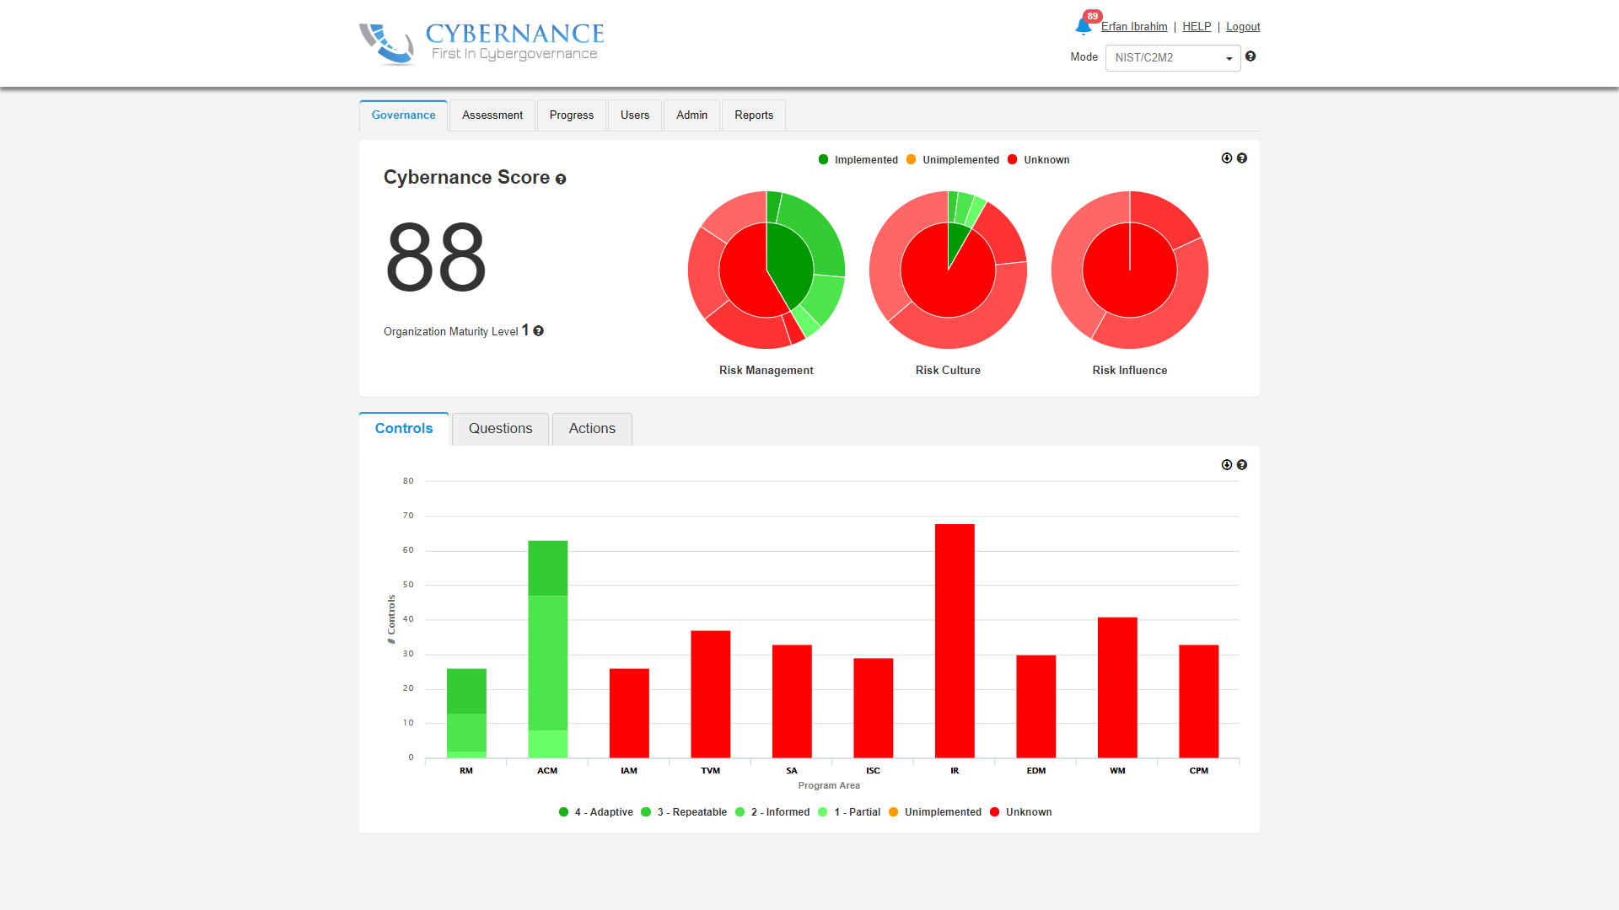
Cybernance CMOM automated software tool
The Bit Bazaar LLC

Slide 7
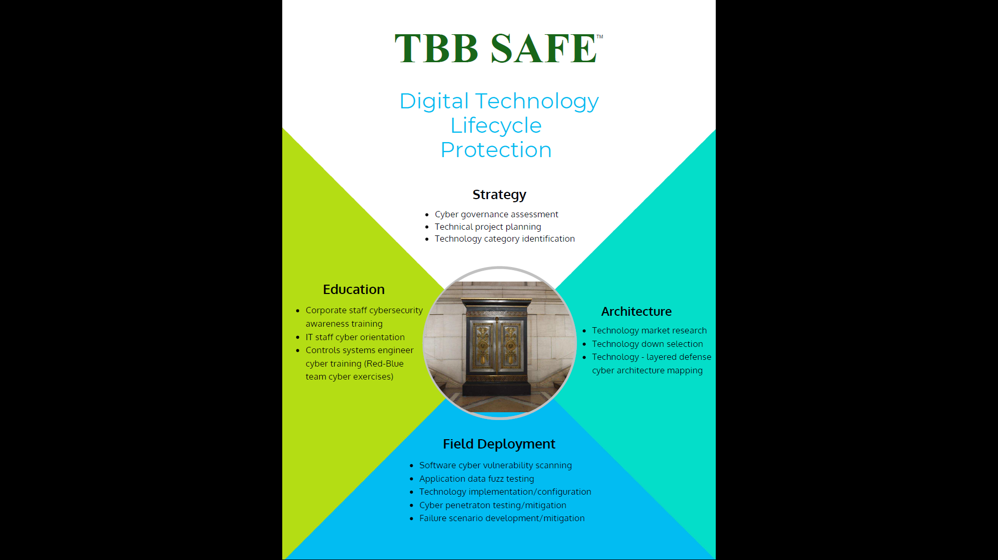
TBB SAFETM methodology for digital technology protection
The Bit Bazaar LLC

Slide 8
Call to action
Be active in your state wide initiatives for cybersecurity
Consider adopting TBB recommended cybersecurity framework at the state level for all critical infrastructure for effective and consistent protection of your data assets from insider and external cyber threats
Decide what tasks you wish to perform internally or outsource to third parties to realize the framework
Perform cyber governance assessment rapidly and cost effectively with TBB using CMOM software (possibility of partial funding assistance from State or Federal subsidies)
Reduce cyber insurance premiums with the implementation of the cybersecurity framework
Don’t hesitate – the time to act is now before a data breach makes you incur high cost to recover (> $3.5 million per incident)
The Bit Bazaar LLC

Slide 9
Grab the cyber bison by its horns – take charge!
Contact Info
Erfan Ibrahim
925-785-5967
erfan@tbbllc.com
www.tbbllc.com

